Slide 1
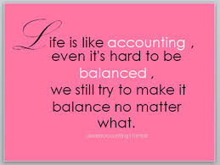

Slide 3
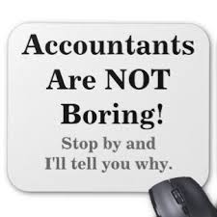

Slide 4
1.

Slide 5
ACCOUNTING
PROFESSION
is PRESTIGIOUS,
IMAGE OF AN ACCOUNTANT IS
UNDOUBTEDLY
POSITIVE

Slide 6
Modern accountant – is a sociable, skillful specialist with a substantial knowledge in different spheres

Slide 7
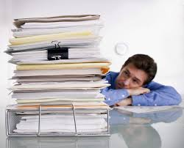
The main components of the
IMAGE OF AN
ACCOUNTANT :
1. Appearance
2. The manner of behaviour
3. Speech
4. Body language
5. Interpersonal space

Slide 8
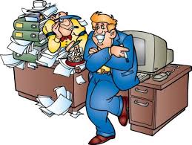
An accountant is considered to be a cultural, well-behaved person, who wears neat business clothes and has good manners

Slide 9
In short, an accountant knows not only the appropriate rules of behavior, but also how to dress in an appropriate way in order to make a good impression

Slide 10
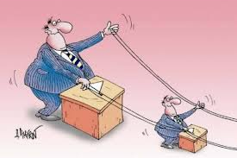
A WOMAN, who works as an accountant is recommended to wear a neat white blouse with a black knee-length skirt and not high-heeled shoes. Also, she should have a beautiful hairdo.
As for MALE accountants they should wear clean ironed shirts, trousers and polished shoes

Slide 11
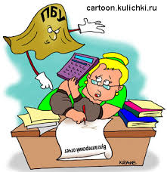
Besides, they are expected to be clean-shaven with clean hair and teeth.
If a male accountant is going for a business meeting it will be a good tone to wear a tie

Slide 12
Professional accountants are required to follow generally accepted moral rules and principles in their actions and decisions , to live and work according to their conscience

Slide 13
In spite of all the above-mentioned aspects of the image it isn’t allowed to forget about such factors as the SINCERITY AND ENTHUSIASM WHEN PERFORMING YOUR PROFESSIONAL DUTIES!

Slide 14
2. accounting is only for gifted and skillful

Slide 15
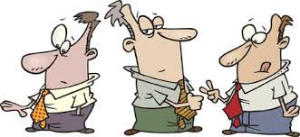
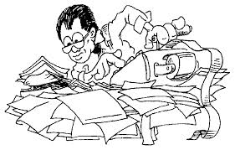
Accountant’s skills
Understanding
Well-Organized and Detail-Oriented
Business Savvy

Slide 16
This OCCUPATION is FOR THE CHOSEN only:
not everyone can become a real accountant, because these well-educated specialists have to be knowledgeable in VARIOUS SPHERES

Slide 17
Spheres of accounting
Owner’s and other internal users
Tax agents
Financial accounting
Bondholders
External investors

Slide 18
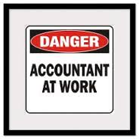
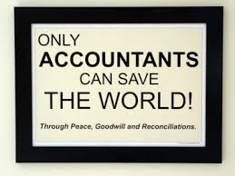
Spheres of accounting
Managerial accounting
Forensic accounting

Slide 19
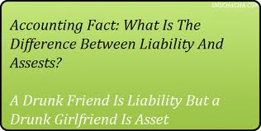
Forensic accounting includes such knowledge as
White-collar crime
Money laundering
Insurance claims
Financial statement fraud
Bankruptcy fraud
Credit card fraud
Damage assessment
Locating hidden assets

Slide 20
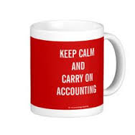
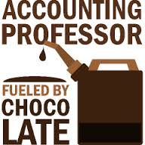
Spheres of accounting
Cost accounting
Auditing
Public accounting
Tax accounting

Slide 21
Skill | Audit Accounting | Tax & Financial | Management Accounting
People skills | Medium | Medium | Medium
Sales skills | Medium | Medium | Low
Communication skills | Medium | Medium | High
Analytical skills | High | Very High | High
Ability to synthesize | Medium | Low | High
Creative ability | Low | Medium | Medium
Initiative | Medium | Medium | Medium
Computer skills | High | High | Very High
Work hours | 40-70/week | 40-70/week | 40-50/week

Slide 22
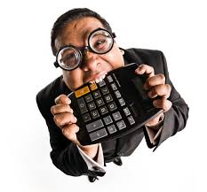
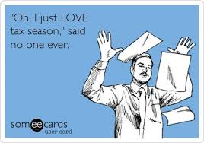
Accountants HAVE TO BE TALENTED individuals and they mostly ARE!

Slide 23
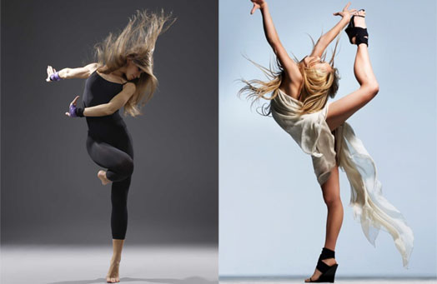
LIFE IS MORE THAN WORK! Accountants do not only play tricks with figures, they often write poems, play violin or piano, paint portraits of dance. A real accountant doesn’t only work, a real accountant lives bright life full of art and joy!

Slide 24
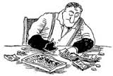
3. accounting is extremely important because accountants Take part in decision making

Slide 25
As a profession, accounting has evolved
in response to society’s need for
economic information to help people
make economic decisions. Accounting is
often called the “language of business”.
Financial information is needed before
any economic decision is made. For the
purpose of decision making, the past is
used as a guide to future estimates of
the consequences of different
alternatives. The accountant can
help significantly in the areas of
budgeting, investigating, interpreting and communicating results for use by both internal and external decision makers.

Slide 26
Decision making in accounting
Successful accountants are able to analyze business data and make appropriate decisions. From determining how to categorize expenses to assessing fraud control measures, decision-making is a critical ability for accountants. Decision-making skills for accounting function as a competitive business advantage and help ensure financial gains and adherence to financial reporting requirements

Slide 27
Kinds of decisions made by an accountant
Data Decisions:
An accountant makes the day-to-day data decisions that are the foundation of accurate and useful reports. Daily decisions can include how to properly classify expenses, what information to use from supporting documents to make journal entries and even how to divide shared expenses between multiple departments

Slide 28
Forecasting
Forecasting
Forecasting skills require highly developed decision-making skills. From determining projected cash flow statements to break-even points, an accountant determines the logical progression of data based on trends and relevant information.
Forecasting skills require highly developed decision-making skills. From determining projected cash flow statements to break-even points, an accountant determines the logical progression of data based on trends and relevant information.

Slide 29
‘Make or Buy’ Analysis
An accountant is able to provide information used in manufacturing process. For example, a small business owner may be considering whether to make or buy a component needed to manufacture the company's primary product. By completing a make or buy analysis, an accountant can determine which choice is more profitable relevant

Slide 30
Consequences
An accountant is vitally important in decision making process and provides a great support for managers and directors

Slide 31
4. This Job Is a very WELL-PAID JOB!

Slide 32
Factors that Affect Salary Potential for Accountants
Industry
Location
SALARY
Education
Job Level

Slide 33
Average and Median Monthly Salary Comparison in Canada

Slide 34
Average and Median Monthly Salary Comparison in United States

Slide 35
Average and Median Monthly Salary Comparison in United Kingdom

Slide 36
Average and Median Monthly Salary Comparison in China

Slide 37
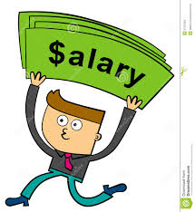
Average and Median Monthly Salary Comparison in Poland

Slide 38
Average Salary of Related Jobs in the USA

Slide 39
…But remember:

Slide 40
5. EMPLOY-MENT STABILITY

Slide 41
An accountant - is not just an expert in accounting, his/her task is
- to pay state taxes on time ,
- to report to the public authorities and to the owners of a company,
- to organize work with clients and partners,
- to monitor the financial status of an enterprise and so on.
But despite all the responsibility of this profession from year to year it is AMONG THE TOP 5 MOST POPULAR EMPLOYERS’ ONES

Slide 42
the Ukrainian portal rabota.ua proves that the number of vacancies available at ACCOUNTING-TAXES-FINANCE Company sectors , increased by 11%
in in 2013

Slide 44
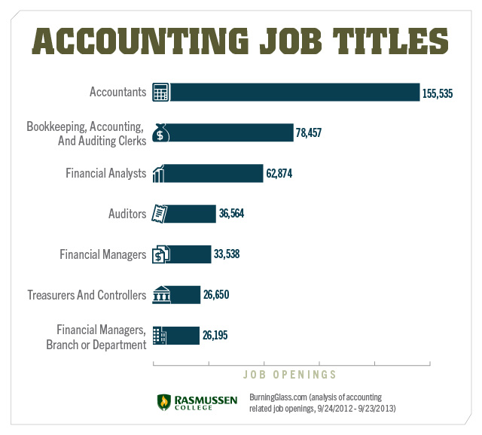
The number of vacancies available in accounting-Taxes-Finance Company in the United States of America (2012-2013)

Slide 45
The most sought-after specialists are accountants (44% of all jobs) and chief accountants (29%)

Slide 46
Almost half of the vacancies in ACCOUNTING-TAXES-FINANCE sections are for Kiyv region (48%).
The proportion of larger cities (Kharkiv, Donetsk, Dnipropetrovsk, Odesa, Lviv) on vacancies is 31%, as well in the other regions it equals 21%

Slide 47
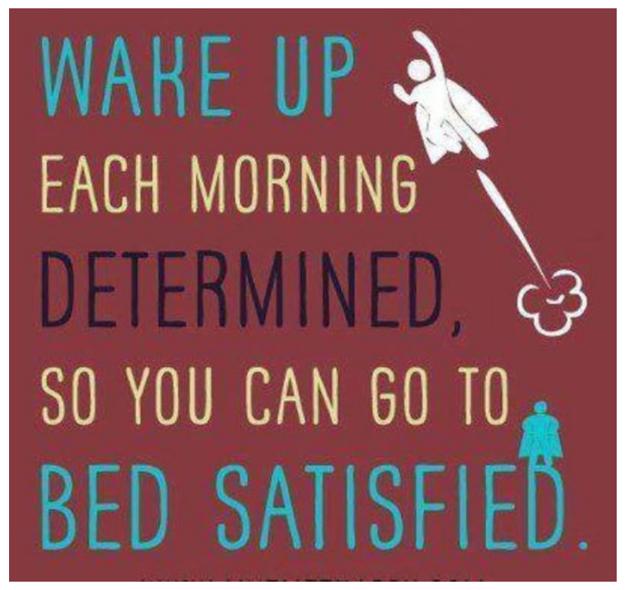

Slide 48
6. Huge availability of job opportu-nities

Slide 49
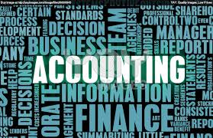
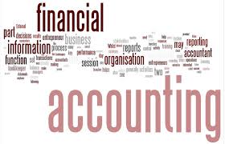
THE ADVANTAGES OF A CAREER AS AN ACCOUNTANT
include a wide range of career choices, various opportunities for professional recognition and advancement.
Accountants can choose careers
in different industries in the public and private sectors,
or they can be self-employed
Accountants may choose to do tax, bookkeeping, payroll or accounting services while others work in government, finance, insurance, manufacturing or company management

Slide 50
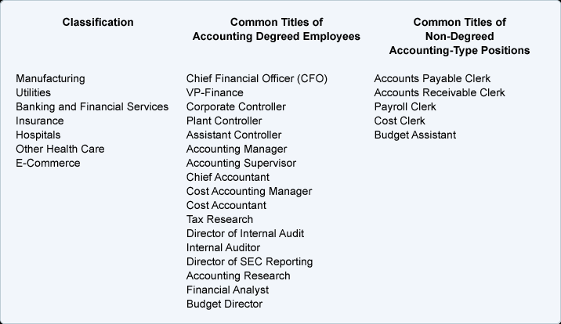

Slide 51
Common Career Paths
Accountants have a variety of career paths from which to choose. Within public accounting, you can work for any sized firm, ranging from a large, international CPA firm to a small local accounting practice.
Within the firm, you can work in such areas as audit, tax and management consulting. In business and industry you can choose careers in companies of all sizes, working in diverse areas such as financial accounting and reporting, management accounting, financial analysis and treasury/cash management. Within government, you can create a path to success at either the federal, state or local level. Non-profit organizations and education also offer many diverse opportunities

Slide 52
Usually, accountants and auditors work in offices, but some work at home. Auditors also may travel to their clients’ workplaces
Many accountants specialize on their client or clients’ type of business and needs. Typical specializations include assurance services and risk management. Accountants can also specialize in a specific industry

Slide 53
THE FOUR MAIN TYPES OF ACCOUNTANTS ARE:
1) Public accountants: Their clients include corporations, governments and individuals. They fulfill a broad range of accounting, auditing, tax and consulting duties
2) Management accountants: Also called cost, managerial, corporate or private accountants. They record and analyze the financial information of the clients they work for, and provide it for internal use by managers, not the public

Slide 54
THE FOUR MAIN TYPES OF ACCOUNTANTS ARE:
3) Government accountants: Maintain and examine records of government agencies, audit private businesses and individuals whose activities are subject to government regulations or taxations
4) Internal auditors: They check for risk management of an organization or businesses' funds

Slide 55
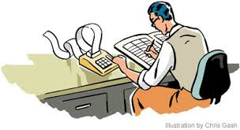
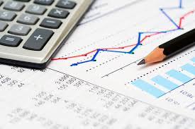
Advancement in the field can have many forms. Entry level public accountants will see their responsibilities increase with each year of practice, and can move to senior positions within a few years
Others may become supervisors, managers or partners. They may also open their own public accounting firms

Slide 56
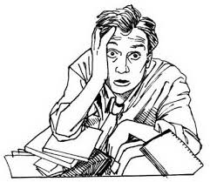
Management accountants often start as cost accountants, or junior internal auditors. They can be promoted to an accounting manager, a chief cost accountant, a budget director or a manager of internal auditing. Some become controllers, treasurers, financial vice presidents, chief financial officers (CFOs) or corporation presidents

Slide 57
7. Possibility to work at home

Slide 59
FREELANCE ACCOUNTANT & ACCOUNTANT-MOONLIGHTER

Slide 60
A freelance accountant, as the name suggests handles the financial accounts of clients they work for. Freelance accountants are mostly hired by small businesses as they cannot afford to have a salaried accountant

Slide 61
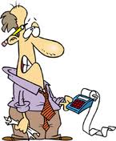
WHY WORK FREELANCE?
In recent years, with the development in remote working technology and in the use of the Internet, it is now far easier to work ‘virtually’ for a number of different clients than it would have been even five years ago

Slide 62
There are many reasons why people choose to work freelance:
1)As a freelancer you have the option to take on as many clients, and as many projects as you like – with total flexibility in your business structure.
2)As well as being able to work very flexibly, freelancers also have the ability to command much higher hourly rates of pay than permanent employees – especially if they are prepared to pout in the extra hours.

Slide 63
Nature of work
As a freelance accountant you are never restricted to work for only companies within your locality, city or even country. With flexible working hours you will get an opportunity to provide your services to clients around the globe

Slide 64
As a freelance accountant your regular tasks include:
1)Recording and saving data related to profits, loss, pending bills, tax, sales and other similar transactions from time to time
2)Tallying the accounts on a daily, weekly or monthly basis
3)Calculating details about tax returns and conveying the same to the client
4)Drafting financial statements whenever asked to
5)Ensuring all financial laws practiced by the company are legal
6)Taking care of the administrative tasks of your own business

Slide 65
Moonlighter - a person who holds a second job (usually after hours)
Today more than one-third of accountants are already moonlighting in “side”
practices or home offices – especially during busy season, according to a CPA
Trendlines survey of almost 800 accountants
And almost half of them work in corporate finance, not where you might expect to find them: in public accounting. So accountants are not only taking more work home with them, they are launching side businesses while keeping their day jobs

Slide 66
About 58 percent of all CPAs surveyed spend at least 11 hours per week in their at-home offices and half of those are working more than 35 hours a week
Few CPAs talk about it openly. But it’s no secret in the profession
Accountants seem to agree that about a third of all professionals are moonlighting at any given time
And they are doing more than just preparing tax returns. Although less than half (44%) of moonlighters say they practice “just mainly in busy season,” 51percent do so “year-round.” So it’s not just about taxes. Some CPAs run fairly sophisticated consulting businesses as side practices

Slide 67
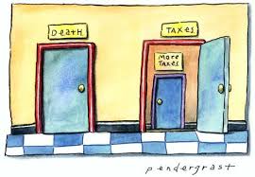

Slide 68
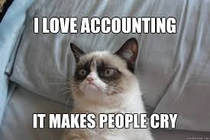
CPAs explain:
«I work full-time at a CPA firm, but also have a small practice which I run from home.
I work full time as a municipality Treasurer, after I sold my full-time CPA practice, but kept 10 percent of my clients that I still service at home.
Approximately one-third of my total income comes from side practice.
I do consulting as an employee through other firms and then I also do consulting through my own company for my own clients».

Slide 71
8. modern accountants SAY NO TO EXTRA-HOURS, work overload and stresses!

Slide 72
modern accountants have plenty of time to devote to their families, leasure and personal development because
ACCOUNTING SOFTWARE MAKES KEEPING ACCOUNTING RECORDS EASIER AND SAVES MUCH TIME

Slide 74
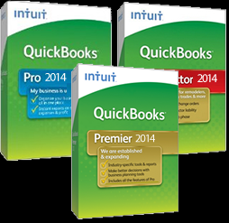
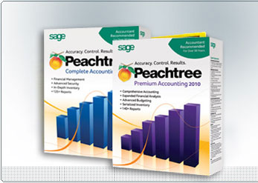
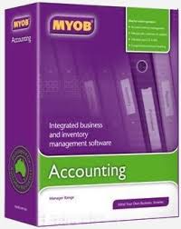
The introduction of computerized accounting systems provides major advantages such as speed and accuracy of transactions, and, perhaps most importantly, the ability to see the real-time state of the company’s financial position

Slide 77
Computers have changed the nature of accounting, turning it into a fast-paced and dynamic profession
Because of automated programs, accountants have more time to:
- interpret data;
- give good financial advice;
- suggest smart business decisions;
- be more involved in their client's business
The accountant has become a business consultant rather than a mathematical tool

Slide 78
A typical computerized accounting package will offer a number of different facilities, that include:
- on-screen input and printout of sales invoices;
- automatic updating of customer accounts in the Sales ledger;
- recording of suppliers’ invoices;
- automatic updating of suppliers' accounts in the purchases ledger;
- recording of bank receipts;
- making payments to suppliers and for expenses;
- automatic updating of the General ledger;
- automatic adjustment of stock records;
- integration of a business database with the accounting program;
- automatic calculation of payroll and associated entries

Slide 79
Speed
Up-to-date information
Accuracy
The main advantages of a computerized accounting system
Availability of information
Automatic document production
Legibility
Cost savings
The ability to deal in multiple currencies easily

Slide 80
To sum up:
Modern accountants are talented, skillful, knowledgeable specialists which work effectively, earn much and at the same time are satisfied with their job opportunities. Accountants are bright self-confident personalities with rich life full of positive emotions, impressions and dreams!
WE ARE FOND OF ACCOUNTING AND WE ARE PROUD TO BE ACCOUNTANTS!

Slide 82
Thank You for attention!
Have a nice day!

